Slide 1
DIRECTIVES HEALTH
Dr.Ilangovan MD
Sr Consultant
American Board Internal Medicine and Palliative care

Slide 2
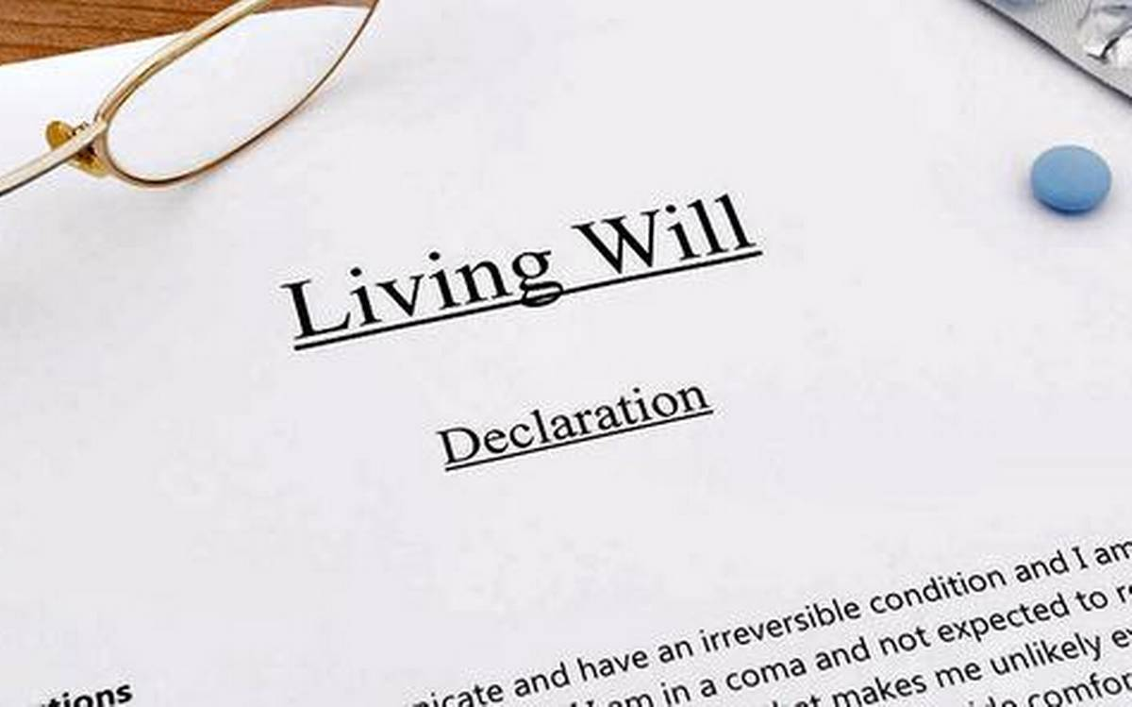
Supreme Court of India on March 9, 2018 permitted living wills and passive euthanasia. The country's apex court held that the right to a dignified life extends up to the point of having a DIGNIFIED DEATH

Slide 3
Why is it important Now
Coronavirus had made many critically ill and brought death unexpectedly and brought spotlight on LIVING WILLS.
The Covid 19 outbreak has put death at the forefront. This has helped start a more nuanced and serious conversation about living wills.
“Doctors are taught to save lives but we also need to let go if the critically ill patient has demanded it in their living will or wishes so. We are talking of an attitude shift here,"

Slide 4
Before Covid19
90% wanted to die at home in their own bed.
In reality 70 – 80% died at a hospital.
To prevent this happening we need DIRECTIVES HEALTH
Only 10% after age of 50 die suddenly
85 – 90% death predictable weeks are months before it occurs ( Cancer, Liver/Cardiac/lung failure, Dementia etc..)

Slide 5
After Covid 19
Tragic health outcomes may occur from infection of Covid 19
Like life-threatening respiratory conditions, extended hospitalization, and the chaos of trying to get medical care from a strained health care system.
Given the dangers of this coronavirus pandemic, it’s wise to make sure you have up-to-date health care directives—that is, a living will ( Directives Health).
For some Elderly, this is their greatest fear: being hooked to a machine, helpless, with the end of life looming. For others, there is hope that the machine might pull them back from the brink, giving them another shot at life. So You can decide (when you can) what you want when you are critically ill.

Slide 6
What is Directives Health
Its like planning a trip you are going to take.
You would like to plan how you are going to travel where you are going to stay.
Now think about having a non curable disease and what kind of journey you want to take in life
You can express what kind of quality of life you want .

Slide 7
Quality of life
What kind of treatment you want ( natural or Placed on machines, Resuscitation measures )
Who you want to make decisions or carry out your wishes for you (Family, Friend, Proxy.. )
Where you want to be treated ( Hospital or Home, Facility etc…)
These are binding refusals and can be revoked if needed under certain circumstances.

Slide 8

Directives Health
Essentially it is for people to plan their future healthcare, especially at a time when they may no longer be able to make decisions or communicate these decisions.
It will help all concerned to understand to know the views, wishes and preferences of the
person at end of life.

Slide 9
Process in Directives Health
SUMMARY
Patients provide their personal details
Nominate decision maker for them
Share information about their living will
Get Declaration, Witness and Attestation of the living will.
Assistance with completing the Living Will

Slide 10
How is it done
Can be initiated by any health care personal who is concerned about a patients care.
Ideally a Doctor initiates the process of contacting DIRECTIVES HEALTH
Call placed through website and Patients contacted through secure call.
Discuss patients future and their wishes . Assist them in completing the living will.
Document it in a secure form.
Secure digital signature on the form from patient and witnesses.
Get a appropriate authority signature digitally
( Judicial Magistrate)
Store it securely and confidentially.
Patient has access to it anytime and can be shared and accessed with their consent

Slide 11
Why it should be done
Patient have the right to determine their own future ( accept or decline therapy)
Patients has a choice of who makes decisions and where to get treated.
Doctors will have the training to tell and Patents has a reason to hear.
Better dignified comfort care for the patients with DIRECTIVES HEALTH.
START YOUR DECISION MAKING TODAY
SHOW IT TO EVERYONE WHO CARES FOR YOU.

Slide 12
Why Directive Health
Its not only a document but a process to make the directives effective.
In an emergency you can access your digilock or document storage which can be shared with the health care provider.
It can be confidentially shared any time you have a health encounter such that the providers are aware of your wishes.

Slide 13
Healthfin and AA
The Issues
Individual’s carry data of their healthcare directives with no framework in place for them to aggregate and share with their benefactors leading to individuals getting unintended care.
This causes suffering and financial burden on the individual and their family
This aggregated data can provide an individual’s wishes and is essential to provide better care for the individual.
An individual or family has to share data themselves either physically or electronically. This is slow and information goes missing compromising appropriate care.
No mechanism exists for a benefactor entity to access a user’s data digitally or physically, even after the user’s explicit consent.
Also, there is no framework available that can let an entity access users’ data even with users’ permissions.
As a result appropriate care is compromised causing unnecessary suffering and financial burden.
Healthcare entities have a problem of getting reimbursed for their services once care is provided especially when care doesn’t explicitly show improvement or death occurs.
Insecurity exists with healthcare providers providing care for seniors and at individuals home regarding reimbursement.

Slide 14
The Solution
The account aggregator are to provide services based on the explicit consent of individuals. This primarily includes transfer, but not storing, of a client’s data providing privacy and confidentiality.
Provides a digital platform like Digilocker for easy sharing and consumption of data from various entities with explicit user consent.
No health information of the user is retrieved, shared or transferred by the Account Aggregator without the explicit consent of the user.
An AA merely acts as a conduit between the Health information user and the individual.
The AA framework facilitates consented sharing of information in real-time and eliminates the above issues while ensuring data privacy.
In future Healthfin can work on real time payment processes for Tele-health consultations, Home care services ( Nursing, Equipment, Rentals etc) directly with AA or through escrow entities so payment issues can be resolved.

